Slide 1

Rainfall in Australia
JARROD KENG YEN YONG (218271795)
HARRY WILLIAM LODGE (218241616)
VIET NAM NGUYEN (218459058)
ALEXANDER PAK YU LAI (218401269)

Slide 2
Introduction
The Australian weather broadcast or the appropriate agencies, comprehends tomorrow's weather, specifically whether it will be raining or not.
Dataset of day-to-day weather collected across various stations over a period of 10 years.
Aim to return prediction of tomorrow rain by producing the possibilities.
Notes:
Alex

Slide 3
Data Description
Categorical Variables
Date
Location
WindGustDir
WindDir9am
WindDir3pm
RainToday
RainTomorrow
Numerical Variable
MinTemp | WindSpeed3pm
MaxTemp | Humidity9am
Rainfall | Humidity3pm
Evaporation | Pressure9am
Sunshine | Pressure3pm
WindGustSpeed | Cloud9am
WindSpeed9am | Cloud3pm
Temp9am | RISK_MM
Temp3pm
Notes:
Nam

Slide 4
Data Cleansing
A
Find and correct errors in categorical variables
B
Count the total number of missing values for each column
C
Drop columns with more than 10% missing values
D
Drop rows with more than 20% missing values
E
Calculate z-score for numerical variables and replace outliers
F
Replace all missing values by implementing appropriate algorithms
Notes:
Nam

Slide 5
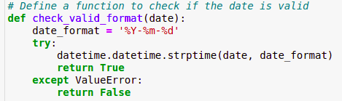
A. Find and correct errors in categorical variables
DATE VARIABLE
Notes:
Nam

Slide 6
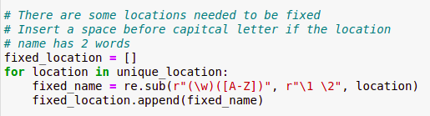
A. Find and correct errors in categorical variables
LOCATION VARIABLE
Notes:
Nam

Slide 7

A. Find and correct errors in categorical variables
WindGustDir | WindDir9am | WinDir3pm
Notes:
Nam

Slide 8
A. Find and correct errors in categorical variables
RAINTODAY | RAINTOMORROW
NO ERRORS
YES
NO
Notes:
Nam

Slide 9
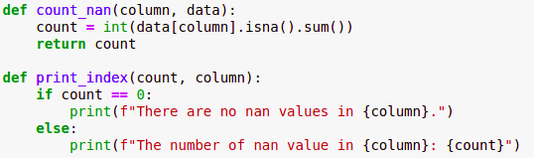
B. Count the total number of missing values for each column
Variables | Total Missing Values
Date | 0
Location | 0
MinTemp | 637
MaxTemp | 322
Rainfall | 1406
Evaporation | 60843
Sunshine | 67816
WindGustDir | 9330
WindGustSpeed | 9270
WindDir9am | 10013
WindDir3pm | 3778
WindSpeed9am | 1348
WindSpeed3pm | 2630
Humidity9am | 1774
Humidity3pm | 3610
Pressure9am | 14014
Pressure3pm | 13981
Cloud9am | 53657
Cloud3pm | 57094
Temp9am | 904
Temp3pm | 2726
RainToday | 1406
RISK_MM | 0
RainTomorrow | 0
Notes:
Nam

Slide 10

C. Drop columns with more than 10% missing values
STEP B
THE NUMBER OF MISSING VALUES
Notes:
Nam

Slide 11
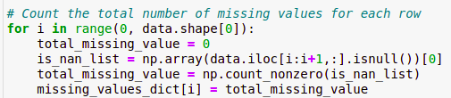
D. Drop rows with more than 20% missing values
ROW
NUMBER OF MISSING VALUE
TOTAL ROW OF DATASET

Slide 12
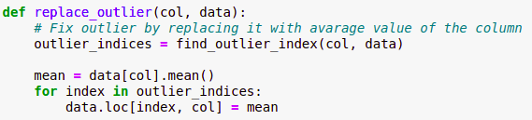
E. Calculate z-score for numerical variables and replace outliers
OUTLITER LOCATION IN DATASET

Slide 13
F. Replace all missing values by implementing appropriate algorithms
MISSING VALUES
WindGustDir
WindDir9am
WinDir3pm
NUMERICAL
RainToday
Linear Regression
Naïve Bayes
Random

Slide 14
Main Structure and Key Variables
A. Information used in analysis
B. Date and location
C. Min temp and Max temp
D. Pressure, Humidity and Temp for 9am and 3pm
E. Rain today and tomorrow
G. The other values

Slide 15
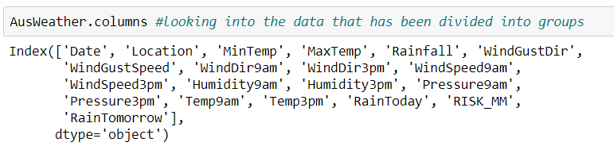
A. Information used in analysis
The list shown is the different values/columns that we could use when analysing the information. It was our job to look at the list of different variables that we could use to help us analyse patterns and trends in the information.

Slide 16
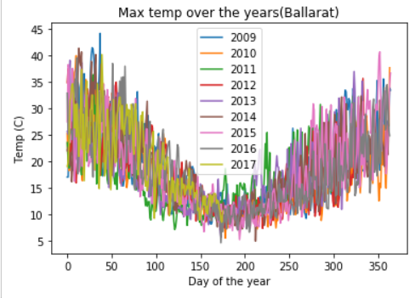
B. Date and location
The main use for these two variables was to help us know the differences between each row of information. Of the 14000+ entries that we had to look into, the combination of the two variables allow us to break all entries into unique rows.
The values could also be broken up when looking into each individual location like when we used the location and date to help us know a specific area's max temp as posted throughout the year. By separating the location and then separating by time, we could get area-based analysis that we could compare against each year's record as shown in our analysis.

Slide 17

C. Min temp and Max temp
The max and min temp are used to show us the maximum temperature and minimum temperature that was recorded on that day. We used these temperatures when we wanted to identify if there was any correlation to temperature rising and falling and any of the other variables.

Slide 18

D. Pressure, Humidity and Temp for 9am and 3pm
Perhaps one of the most useful sets of variables that we could use so that we could observe the amount difference between the morning and afternoon.
As we originally didn’t find much information in the section where there was a rise in temperature during the day. We used pressure and humidity as the key values we looked into for the analysis and helped us reach a usable conclusion with our studies.

Slide 19

E. Rain today and tomorrow
These were the key values that we used to make sure our assumptions were correct. The aim of these variables were to help us identify if there was rain on the following day. By using that information we could predict based on the values given to us if there would be “rain today” on the following day without the need for additional analysis.

Slide 20

G. The other values
The rest of the values, while useful, weren't used too much in our calculations and meant that we didn’t have a way to use them during the analysis, other than the generic analysis that we had used during testing that we had used so that we could make sure all our calculations for both data cleaning and predicting are correct.

Slide 21
Data Patterns

Slide 22
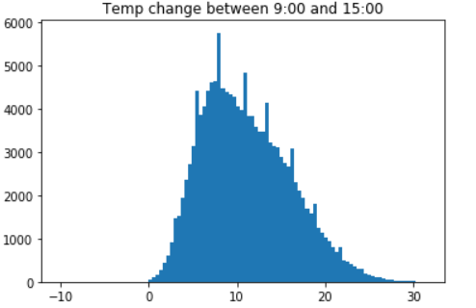
Temp Based Patterns
The final pattern that was plotted and observed in relation to the temperature was when we plotted the change in temp between 9AM and 3PM for all entries in the table. When we plotted the information, we managed to get a plot vaguely matching the bell curve.

Slide 23
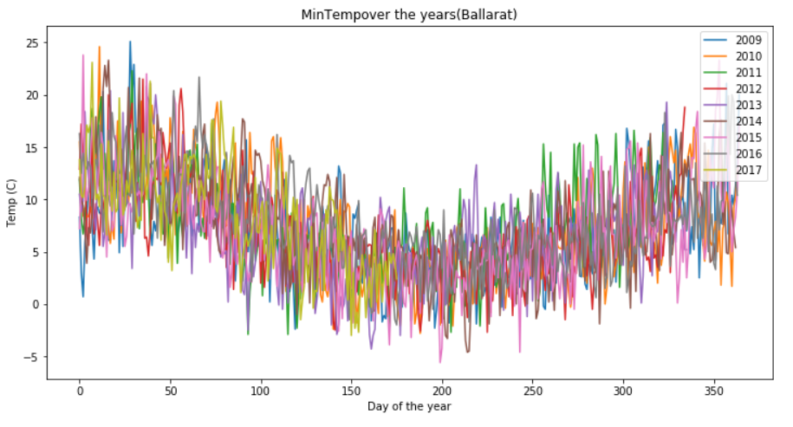
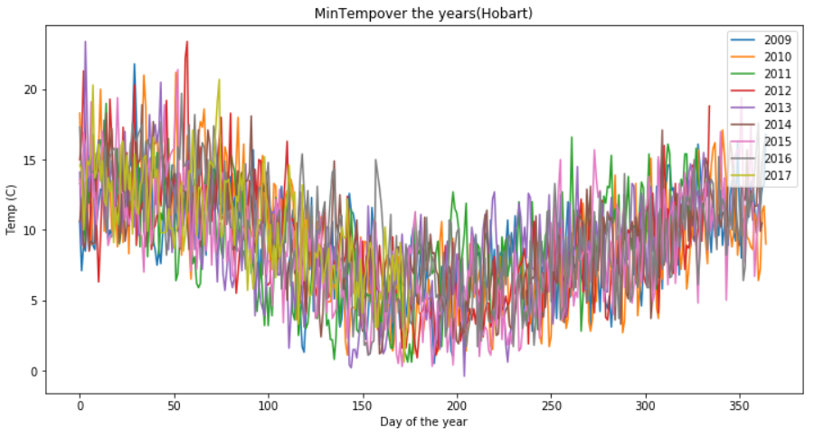
Temp Based Patterns
Max temp over the year:
One of the patterns we observed was when we observed when looking at the max temp and min temp of locations, there was a fairly erratic to all the information as shown by the graphs. It was however noted that while it does fall into a curve that is common throughout the year, causing a sine wave.

Slide 24
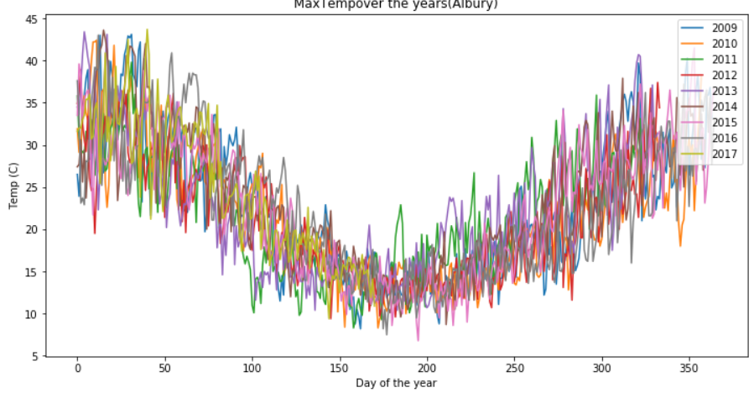
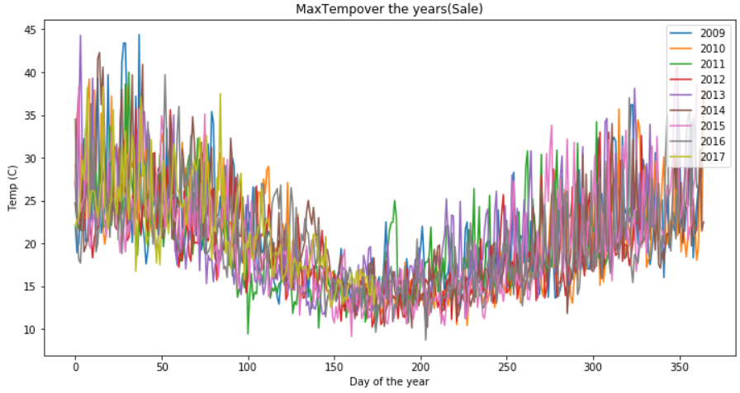
Temp Based Patterns
It was noticed however that the max temp manages to shorten the curve's variation over the winter months. As shown by the graphs below show, there is a dip in the variation during the winter months with that trend being observed with all the locations.

Slide 25
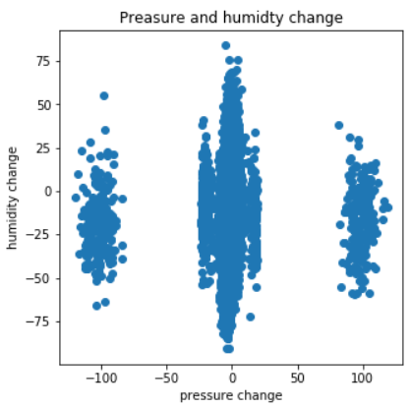
Humidity and pressure
Having looked at the trends that we observed in which we saw that we could predict rain >50% of the time, we decided to see if there was a trend in the rise in humidity that correlated with the rise in pressure, while we didn’t manage to get usable information, we were able to notice that when plotted, the information made a graph that was interesting nonetheless and made the information somewhat predictable.

Slide 26
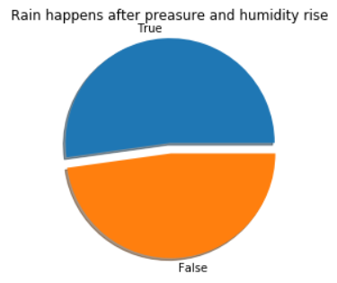
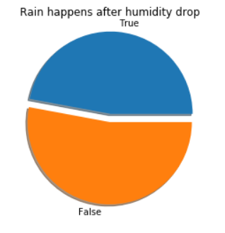
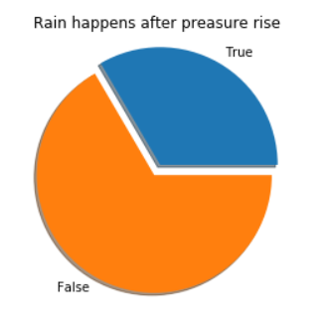
Humidity and pressure
The other main observation that was observed while looking at the information was us following our assumptions.
We had presumed that the humidity was related to rainfall, specifically an increase in humidity during the day meant that there was a change for rain, as we later observed that while this was true, pressure also correlated when there is a rise in both.
While this was good news it was found that pressure only mattered in predicting with humidity as the pressure rise in relation to rain was almost negligible.

Slide 27
Data Testing
a. Find and identify the values in question
b. Setting up the DataFrame and preparing for Training and Testing
c. Training and Testing the dataset

Slide 28
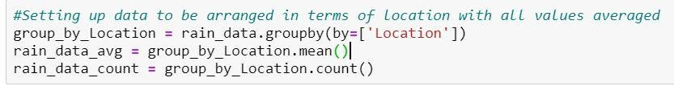
a. Find and identify the values in question
RainTomorrow was target variable
Once all those values are 1 and 0 respectively the column of “RainTomorrow” can be used within the modelling data further on. Staging the next steps involved ensuring that each value could be grouped and averaged to create a more generalised set. This would contain locations to see averages in each area and to see if values counted are also consistent or slightly imbalanced.

Slide 29

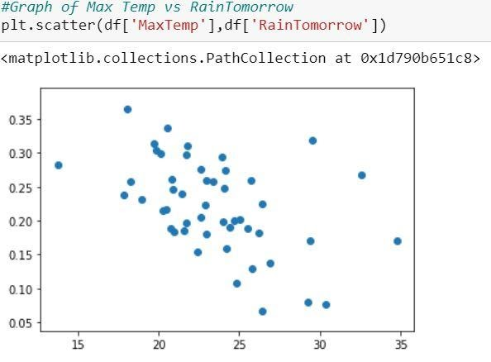
b. Setting up the Data Frame and preparing for Training and Testing
As this model will be looking at locations and their relation to “RainTomorrow” the DataFrame will be set to the group by location done earlier.
The application of head was used to check that the first 15 values corresponded with the prior group_by_location.mean() table and no errors had occurred in between.

Slide 30
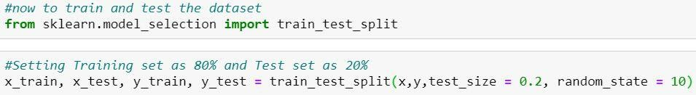
b. Setting up the Data Frame and preparing for Training and Testing
To prepare for Train and Test Split both x and y values must be defined. In this case Max and Min Temp will be “x” and RainTomorrow will be the “y” values. The machine learning library was to be imported and used next. Since it uses numpy extensively for high-performance linear algebra and array operations it’ll assist with modelling the data and checking its accuracy via Testing and Training.
The random state was set at a specific number in order to keep pulling from that segment in the training set for consistency reasons.

Slide 31
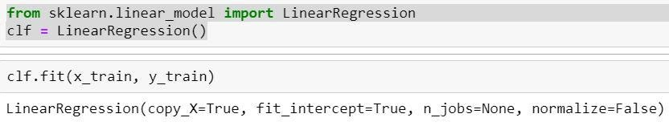
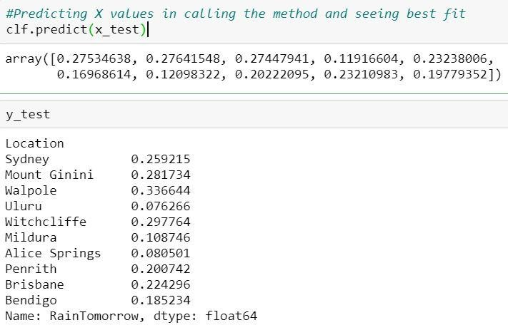
c. Training and Testing the dataset
First off, importing linear regression as Min and Max Temp want to be tested as a potential variable to the dependent variable RainTomorrow.
This takes all our values into the train set and checks to see if there is a potential fit and to determine values for testing.

Slide 32
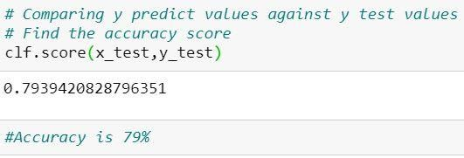
c. Training and Testing the dataset
To summarize, the train_test_split function is for splitting a single dataset for two different purposes: training and testing. The testing subset is for building the model. The testing subset is for using the model on unknown data to evaluate the performance of the model. This in turn allows us to see the accuracy and properties potentially of the dataset.
As seen in the picture above the models accuracy was 79% however this was only given the data for Max and Min Temperatures and can be further used to test other variables.

Slide 33
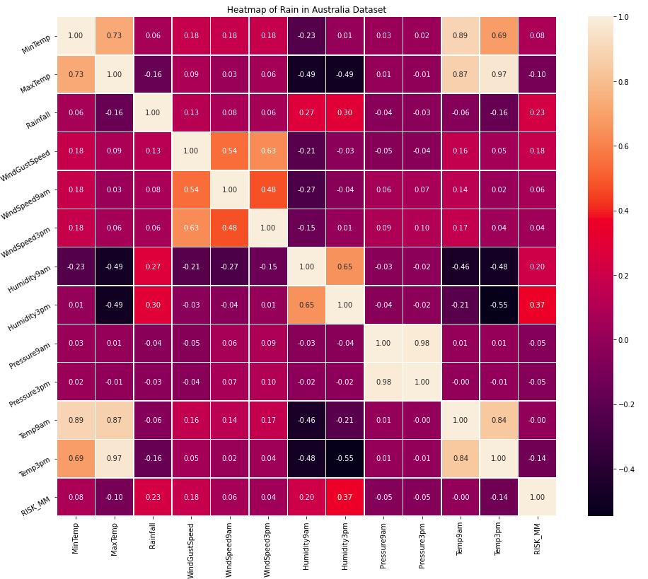
Correlations and Assumptions

Slide 34
Correlations and Assumptions
Variable 1
Correlation Coefficient > 0
Variable 2
Assist
High Performance
Training/Testing Linear Regression model
More Accurate Prediction

Slide 35
Conclusion
Observations in data
Testing and analysis of the “Rain in Australia” data-set visualized to be utilized in real life scenarios
Patterns in temperatures in Australia were erratic and data on humidity and pressure, able to view trends that would help.

Slide 36
Conclusion
Obstacles:
Struggle in implementing Naive Bayes .
Dealing with dimension of matrix to fit Linear Regression .
To calculate z-score first before drop columns with 20% of the values missing.
Not getting the heatmap to work for a specific location after 3 attempts to recreate it from scratch.
Having the data displayed/visualized incorrectly.

Slide 37
Conclusion
Solutions:
Learned content and previous tasks
Online sources and articles
Other students and collogues

Slide 38
References
Bureau of Meteorology n.d., Note to accompany Daily Weather Observations, Australian Government, retrieved 18 April 2020, <http://www.bom.gov.au/climate/dwo/IDCJDW0000.shtml>.
Hunter, J, Dale, D, Firing, E & Droettboom, M n.d.,The Matplotlib development team, retrieved 18 April 2020, <https://matplotlib.org/>.
Young, J 2017, Rain in Australia, Kaggle, retrieved 18 April 2020, <https://www.kaggle.com/jsphyg/weather-dataset-rattle-package>.

